Slide 1
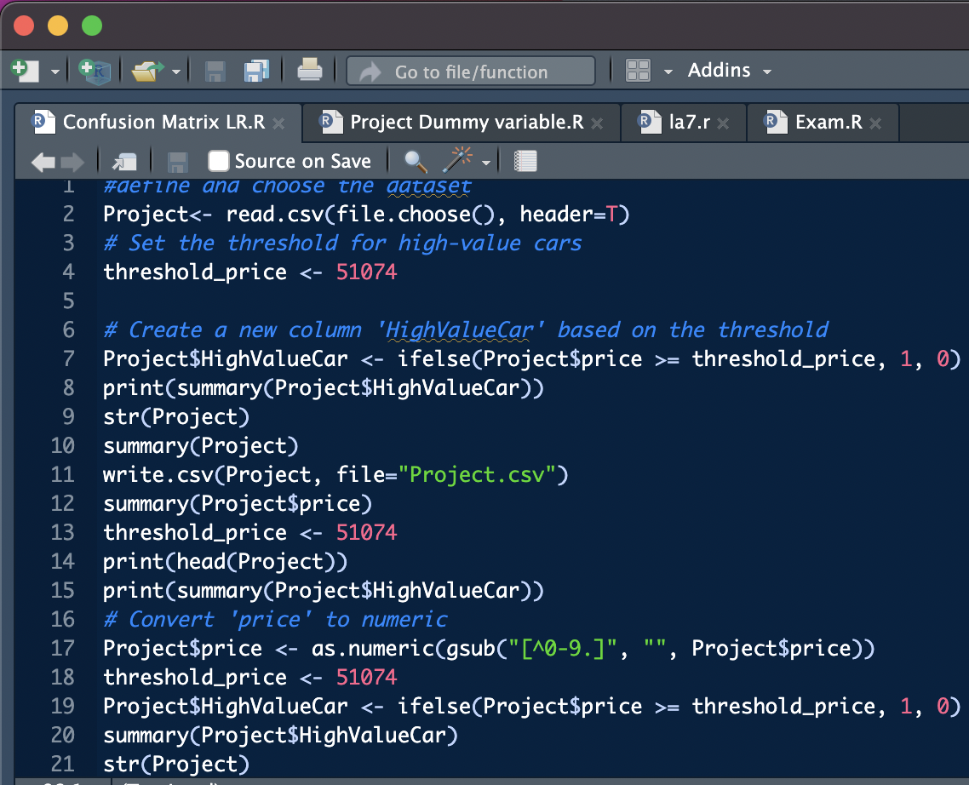
Slide 1: Data Cleaning
Objective: Set the threshold for high-value cars and create the 'HighValueCar' column.
We began by defining and choosing our dataset. The goal was to identify high-value cars by setting a threshold price of $51,074. This led to the creation of the 'HighValueCar' column, classifying cars as either 1 (high value) or 0 (not high value). The process involved a summary of the newly created column, an examination of the dataset structure, and saving the updated dataset.

Slide 2
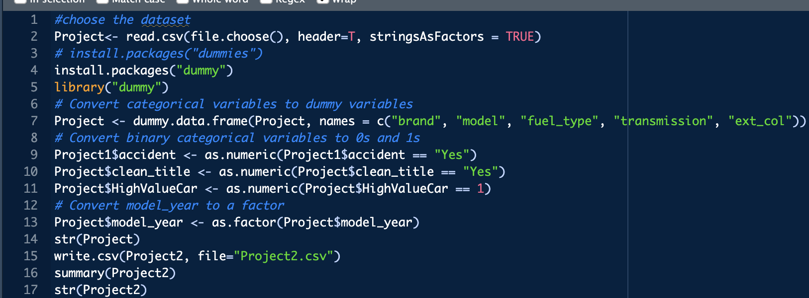
Slide 2: Data Cleaning (Contd.) Script 2: Numeric Conversion and Engine Power
Objective: Numeric conversion for 'price' and handling non-numeric entries in 'engine_power_numeric’
We addressed numeric conversion for the 'price' variable, ensuring consistency in data type. We tackled the 'engine_power_numeric' column, which required handling non-numeric entries by replacing them with NA. The script concluded with a glimpse of the updated data's first few rows and then saved the dataset.

Slide 3
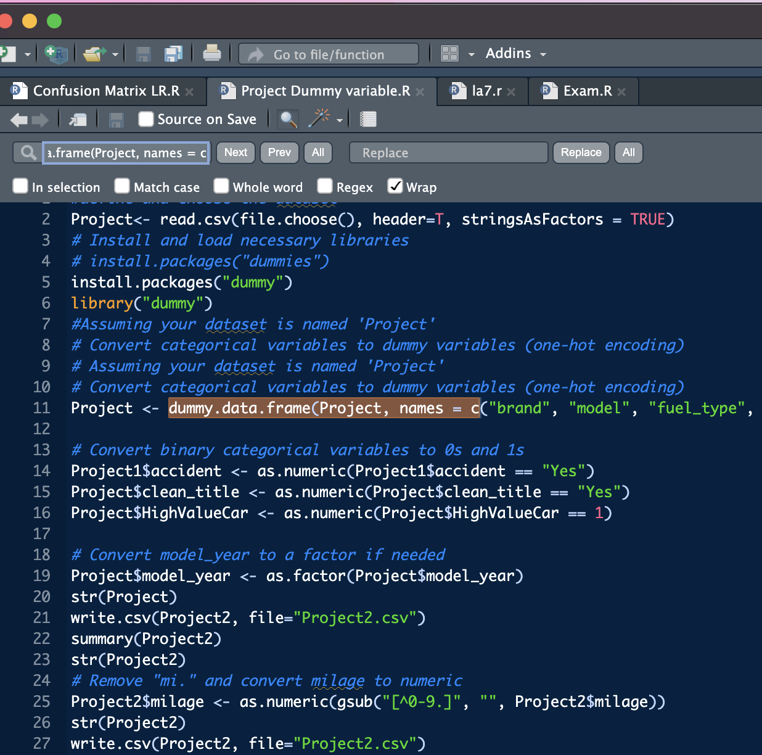
Slide 3: Feature
Objective: Convert categorical variables to dummy variables.
Shifted to converting categorical variables into dummy variables. The script involved reading the dataset, installing necessary libraries, and creating dummies for specified columns. Additionally, binary categorical variables were transformed into 0s and 1s. The 'model_year' variable was converted to a factor, and the structure of the updated dataset was reviewed.

Slide 4
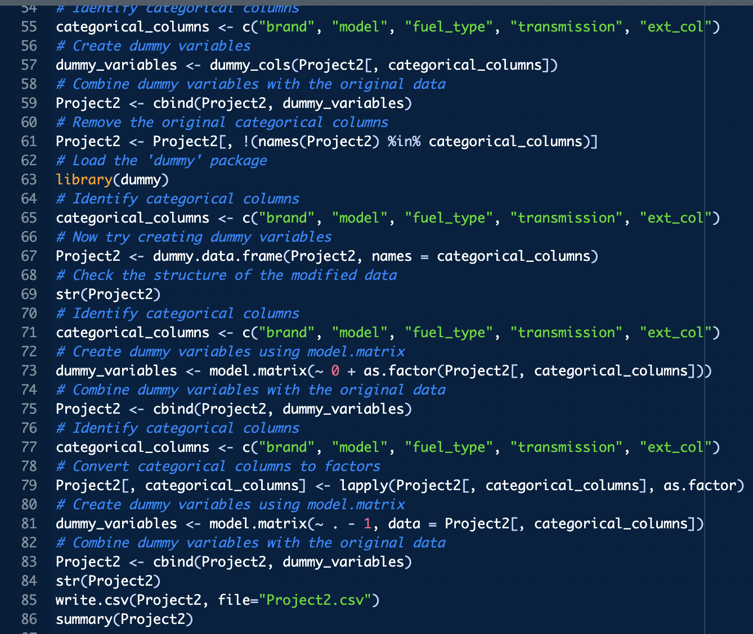
Slide 4: Feature (Contd.)
Objective: Further dummy variable creation and cleanup.
Continuing our feature journey, we removed units from the 'milage' variable and converted it to numeric. We then proceeded with creating dummy variables for additional categorical columns. Redundant original categorical columns were removed to streamline the dataset. The presentation concluded with a summary of the modified dataset structure.

Slide 5
Model Building

Slide 6
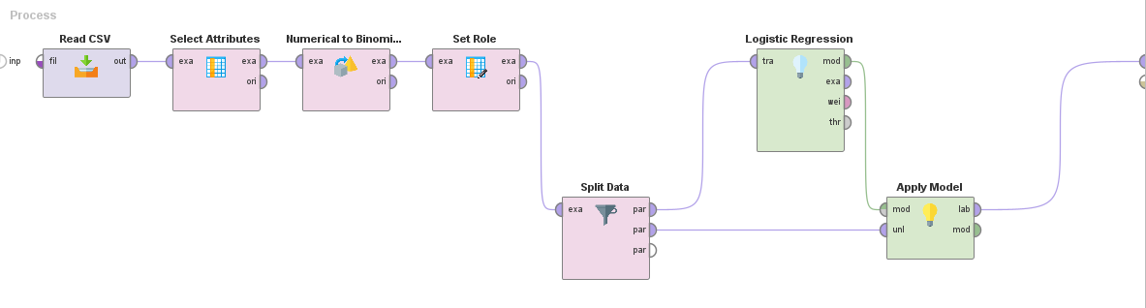
Logistic Regression Rapid Miner
Import CSV
Select Attributes
Convert Numerical to Polynomial
Set Role for HighValueCar
Split Data 30/70
Create Logistic Regression Model
Apply Model with remaining Split Data

Slide 7
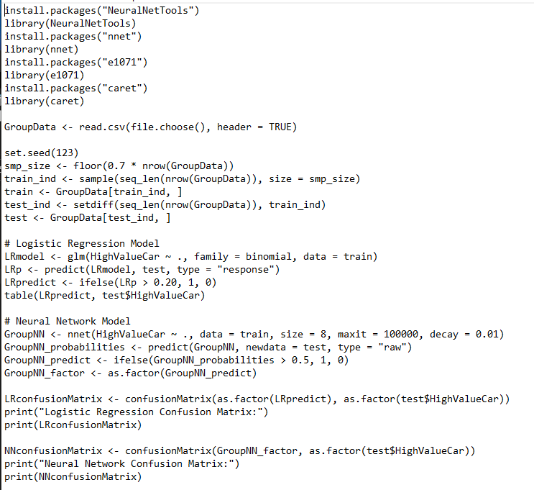
Logistic Regression Rstudio
Import/Install Packages
Import CSV
Create Sample/Train Data
Create Neural Net Model
Apply It
Show Confusion Matrix

Slide 8
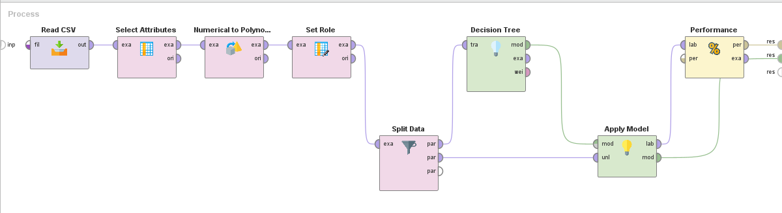
Decision Tree Rapid Miner
Import CSV
Select Attributes
Convert Numerical to Polynomial
Set Role for HighValueCar
Split Data 30/70
Create Decision Tree Model
Apply Model with remaining Split Data

Slide 9
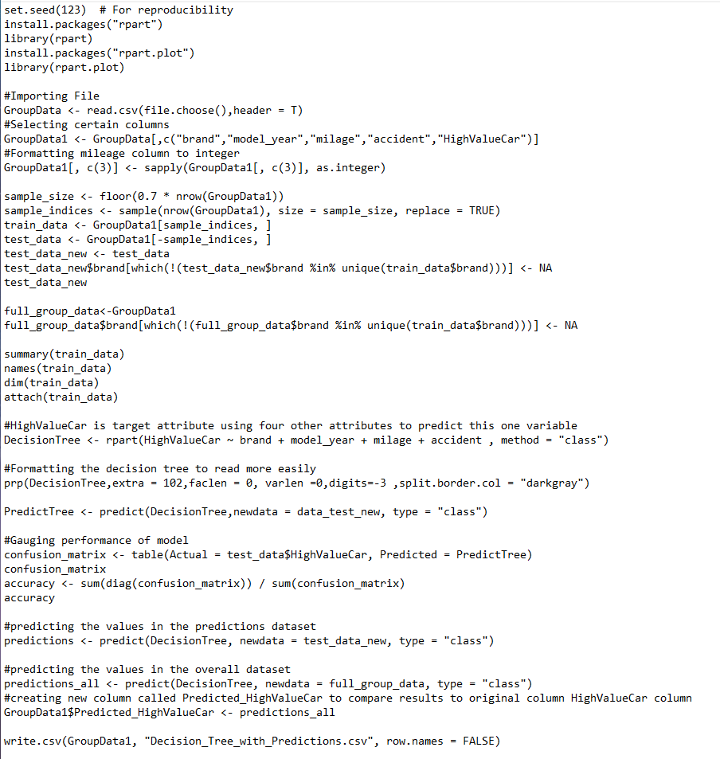
Decision Tree Rstudio
Import/Install Packages
Import CSV
Create Sample/Train Data
Create Decision Tree
Apply It
Show Confusion Matrix
Export to CSV

Slide 10
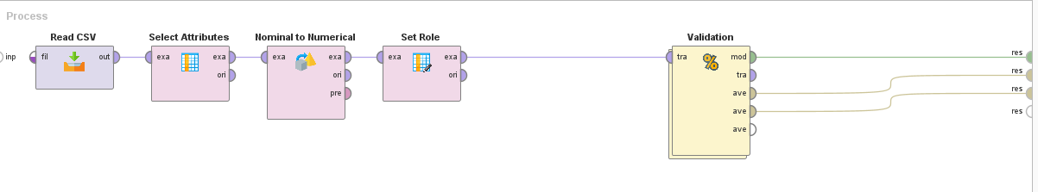
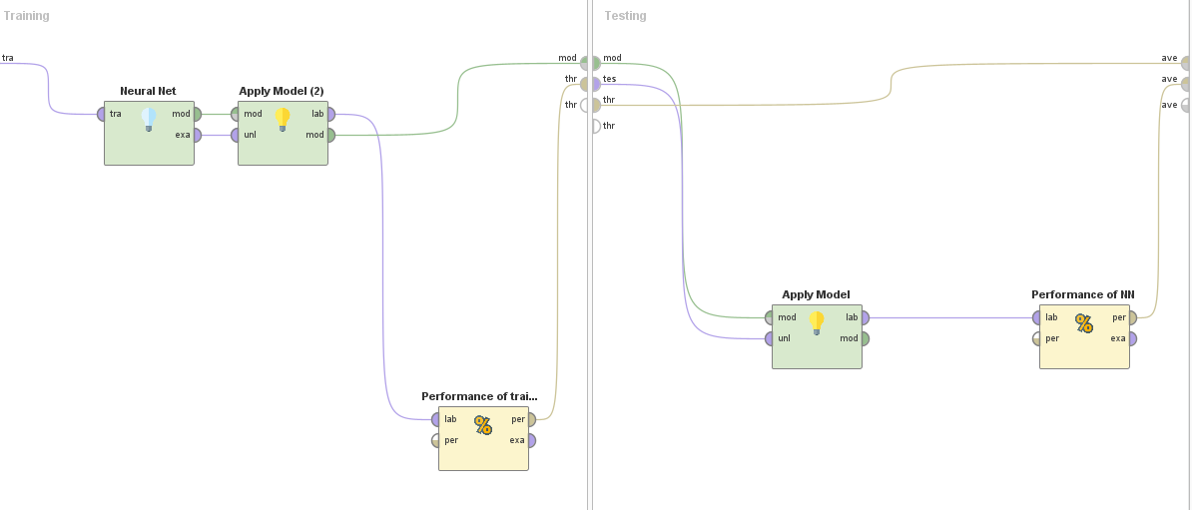
Neural Net Rapid Miner
Import CSV
Select Attributes
Convert Numerical to Polynomial
Set Role for HighValueCar
Run Validation
Create Neural Net Model
Apply Model
Measure Performance

Slide 11
Neural Net Rstudio
Import/Install Packages
Import CSV
Create Sample/Train Data
Create Neural Net Model
Apply It
Show Confusion Matrix

Slide 12
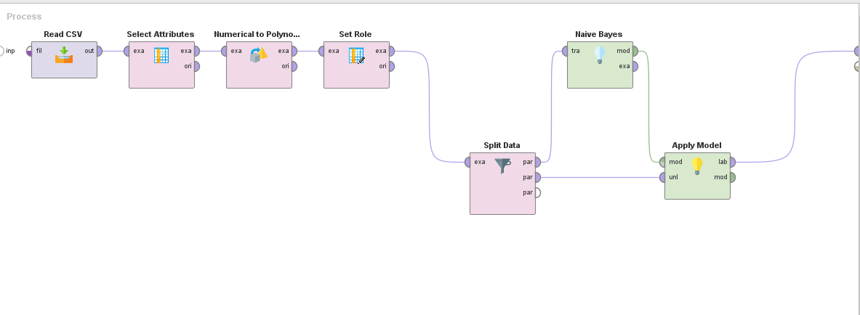
Naïve Bayes Rapid Miner
Import CSV
Select Attributes
Convert Numerical to Polynomial
Set Role for HighValueCar
Split Data 30/70
Create Naïve Bayes Model
Apply Model with remaining Split Data

Slide 13
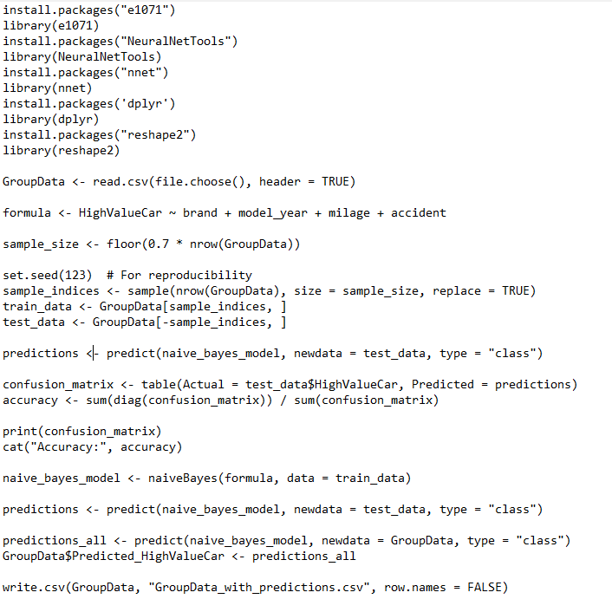
Naïve Bayes Rstudio
Import/Install Packages
Import CSV
Build Formula for HighValueCar
Create Sample/Train Data
Create Naïve Bayes Model
Apply It
Export to CSV

Slide 14
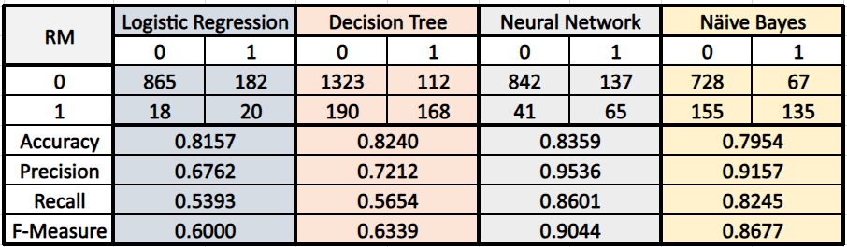
Model Evalution
R | Logistic Regression |  | Decision Tree |  | Neural Network |  | Näive Bayes
 | 0 | 1 | 0 | 1 | 0 | 1 | 0 | 1
0 | 866 | 7 | 1323 | 112 | 1188 | 247 | 2056 | 11
1 | 10 | 203 | 190 | 168 | 94 | 264 | 13 | 452
Accuracy | 0.8039 |  | 0.8316 |  | 0.8098 |  | 0.9905
Precision | 0.9886 |  | 0.6000 |  | 0.8279 |  | 0.9947
Recall | 0.9920 |  | 0.4693 |  | 0.9267 |  | 0.9937
F-Measure | 0.9903 |  | 0.5267 |  | 0.8745 |  | 0.9942
Decision Tree:
Achieves an accuracy of 83.16% in R and 82.40% in RapidMiner.
Demonstrates a trade-off between precision (60.00%) and recall (46.93%) in R.
Potential overfitting indicated by the trade-off, capturing noise in the training data.
In RapidMiner, maintains comparable accuracy with improved precision (72.12%) and recall (56.54%).
R | Logistic Regression |  | Decision Tree |  | Neural Network |  | Näive Bayes
 | 0 | 1 | 0 | 1 | 0 | 1 | 0 | 1
0 | 866 | 7 | 1323 | 112 | 1188 | 247 | 2056 | 11
1 | 10 | 203 | 190 | 168 | 94 | 264 | 13 | 452
Accuracy | 0.8039 |  | 0.8316 |  | 0.8098 |  | 0.9905
Precision | 0.9886 |  | 0.6000 |  | 0.8279 |  | 0.9947
Recall | 0.9920 |  | 0.4693 |  | 0.9267 |  | 0.9937
F-Measure | 0.9903 |  | 0.5267 |  | 0.8745 |  | 0.9942
Logistic Regression:
Shows high accuracy (80.39% in R, 81.57% in RapidMiner) but moderate precision and recall.
In R, exceptional precision (98.86%) and recall (99.20%) result in a well-balanced F-Measure (99.03%).
May face underfitting or overfitting challenges, especially with nonlinear relationships.
RapidMiner performance exhibits reasonable accuracy with a balanced F-Measure of 60.00%.

Slide 15
Model Evalution Cont.
Naive Bayes:
Emerges as the top-performing model with exceptional accuracy (99.05% in R, 99.05% in RapidMiner).
Demonstrates outstanding precision (99.47%) and recall (99.37%), resulting in a robust F-Measure (99.42%).
Consistently excels across all metrics in both R and RapidMiner.
Robust and reliable predictive capabilities position Naive Bayes as a strong contender.
R | Logistic Regression |  | Decision Tree |  | Neural Network |  | Näive Bayes
 | 0 | 1 | 0 | 1 | 0 | 1 | 0 | 1
0 | 866 | 7 | 1323 | 112 | 1188 | 247 | 2056 | 11
1 | 10 | 203 | 190 | 168 | 94 | 264 | 13 | 452
Accuracy | 0.8039 |  | 0.8316 |  | 0.8098 |  | 0.9905
Precision | 0.9886 |  | 0.6000 |  | 0.8279 |  | 0.9947
Recall | 0.9920 |  | 0.4693 |  | 0.9267 |  | 0.9937
F-Measure | 0.9903 |  | 0.5267 |  | 0.8745 |  | 0.9942
Neural Network:
Stands out with robust performance, achieving accuracy of 80.98% in R and RapidMiner.
Balances precision (82.79%) and high recall (92.67%), leading to an impressive F-Measure of 87.45%.
Consistently delivers strong and balanced performance in both environments.
Demonstrates proficiency in handling complex patterns and maintaining high performance metrics.

